Slide 1

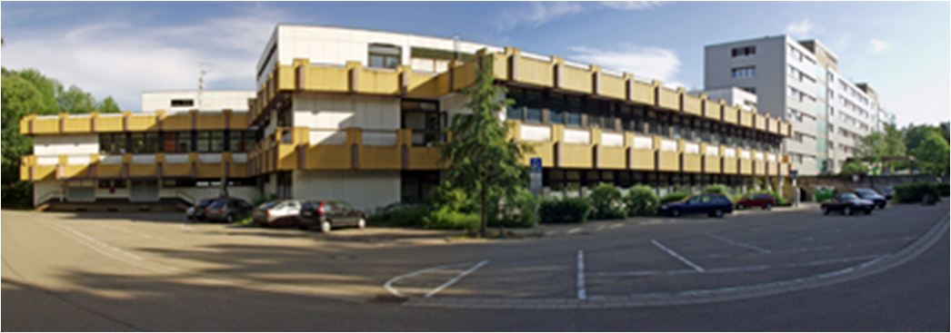
Closed Loop Virtual Reality
for the treatment of acrophobia
01.04.2018
Dominik Limbach
1

Slide 2
Outline
Introduction
Problem Analysis and Goals
Materials and Methods
Results
Discussion
Conclusions and Future Work
References
01.04.2018
Presenter
2

Slide 3
Introduction
Acrophobia
extreme or irrational fear of heights
Specific Phobia
anxiety disorder related to the exposure to specific objects or situations
triggered by presence and anticipation
characteristic avoidance behaviour towards the fear stimulus
01.04.2018
Dominik Limbach
3

Slide 4
Introduction
Exposure Therapy
graded confrontation with the feared object or situation
goal is the reduction of avoidance and fear all together
superior method of treatment (Wolitzky-Taylor et al. 2008)
Key factors: elicit fear, provide corrective information
to enable emotional processing
01.04.2018
Dominik Limbach
4
Notes:
Emotional processing can be described as a
process by which accurate information is implemented into the fear structure and alters
the pathological elements in the structure. However, more recent studies suggest that
exposure therapy rather creates competing structures that do not include pathological
associations among stimulus, response and meaning representation instead of altering
existing ones (Foa and Kozak (1986))

Slide 5
Introduction
01.04.2018
Dominik Limbach
5

Slide 6
Problem Analysis and Goals
design of a virtual environment for the treatment of acrophobia
implementation into a closed loop system
measurement and analysis of physiological fear response
01.04.2018
Dominik Limbach
6

Slide 7
Problem Analysis and Goals
Requirements for the VR
provides adequate fear stimuli
adaptable to different degrees of fear
can be controlled at all times
01.04.2018
Dominik Limbach
7

Slide 8
Materials and Methods
Virtual Environment
Primary fear stimulus
Presentation of height
Modulating factors
depth
Floor opening
Bridge size
01.04.2018
Dominik Limbach
8

Slide 9
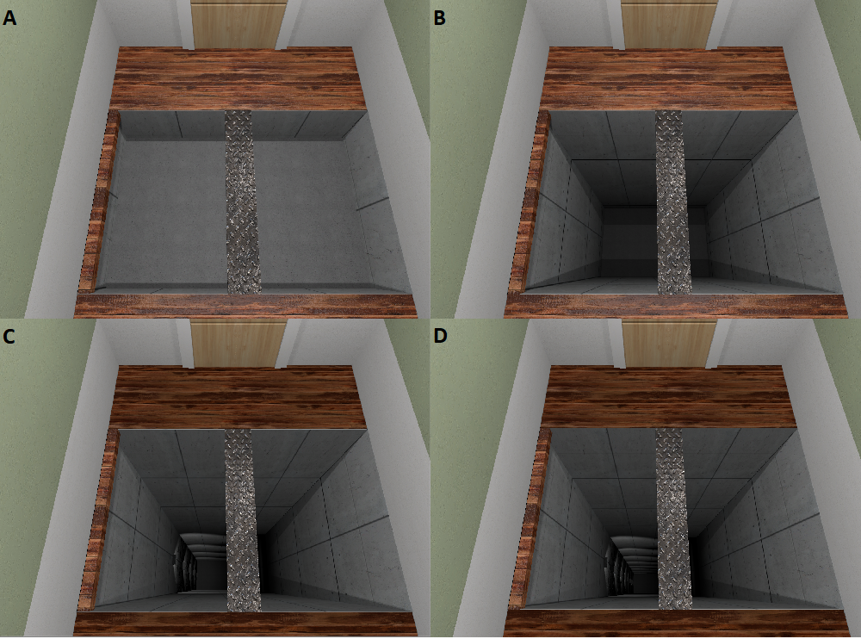
Materials and Methods
01.04.2018
Dominik Limbach
9

Slide 10
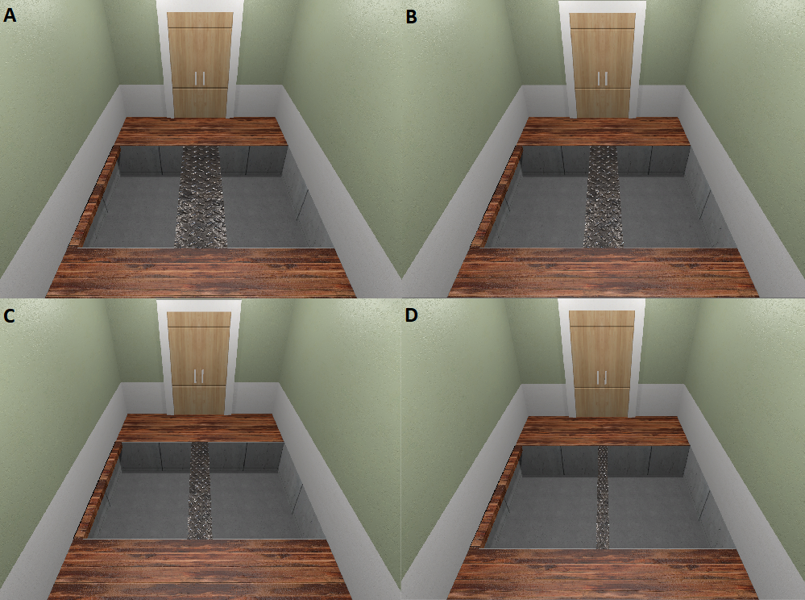
Materials and Methods
01.04.2018
Dominik Limbach
10

Slide 11
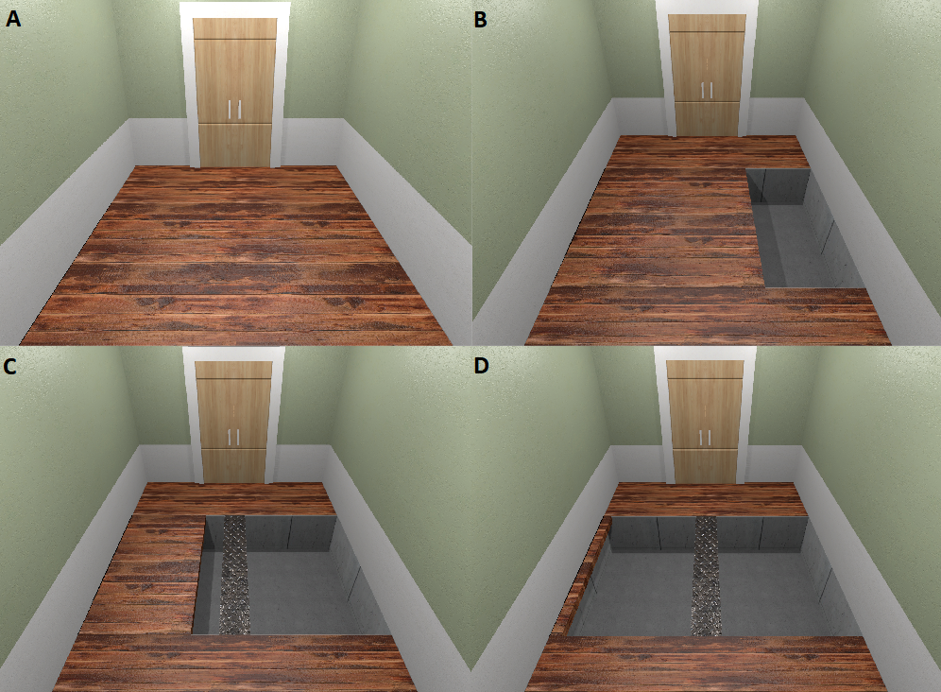
Materials and Methods
01.04.2018
Dominik Limbach
11

Slide 12
Materials and Methods
VR control
Matlab script ( flow chart) creates data vector encodes it creates tcpip object sends data to port
Unity script reads stream received by tcp object and encodes data then reads array segments as information
Game objects and components access the central server script and extract information every frame
01.04.2018
Dominik Limbach
12

Slide 13
Materials and Methods
Experiment
11 subjects 6m/5f
Baseline measurement , exposure procedure
Cross twice while looking down , between each lap alteration
01.04.2018
Dominik Limbach
13

Slide 14
Materials and Methods
Data processing
Preprocessing
Filtering
Feature extraction
01.04.2018
Dominik Limbach
14

Slide 15
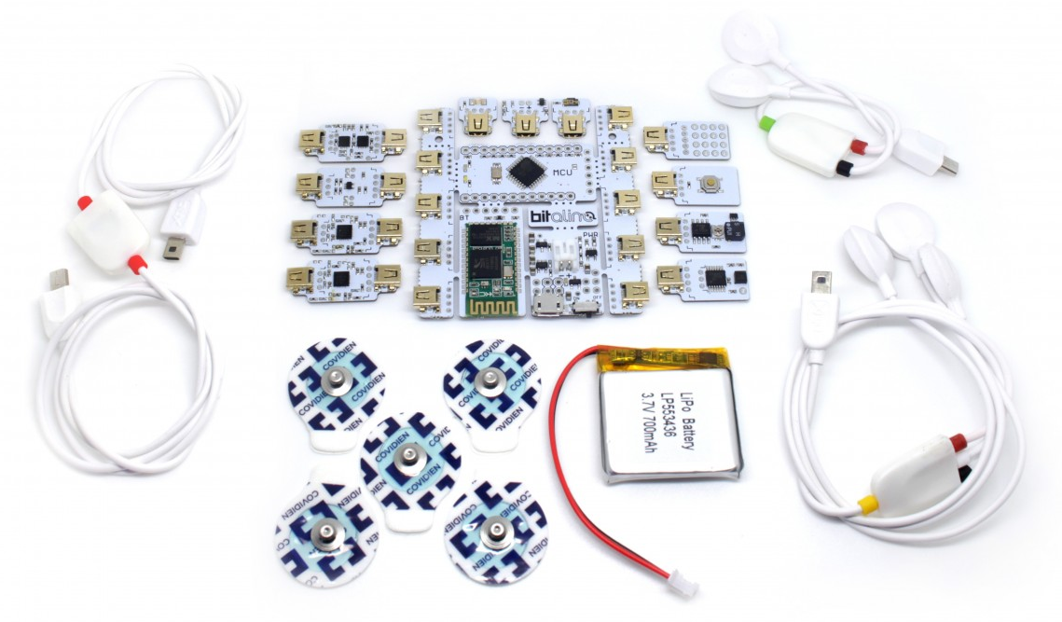
Materials and Methods
BITalino
low-cost toolkit developed for rapid prototyping of wearable devices
and biomedical signal acquisition
Sampling Rate: 1, 10, 100 or 1000Hz
Communication: Bluetooth
Sensors: ECG, EDA
Electrode placement
01.04.2018
Dominik Limbach
15

Slide 16
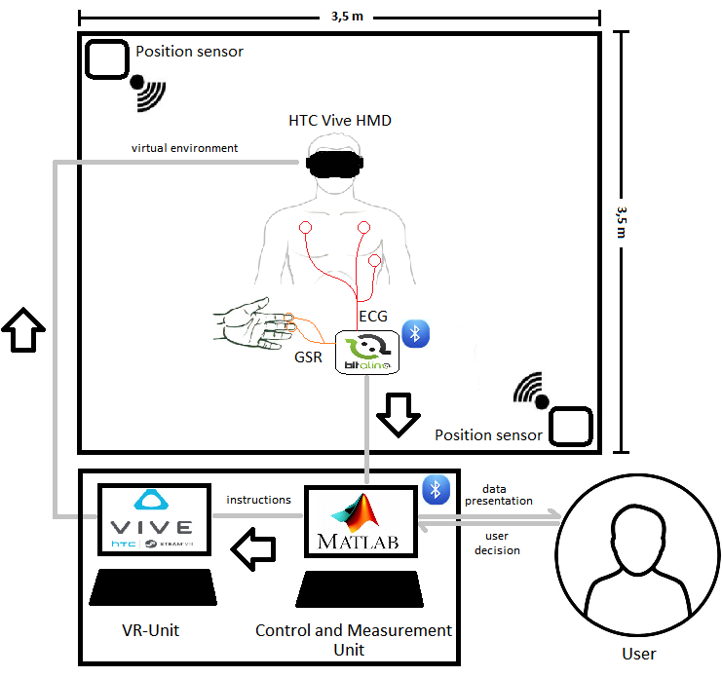
Materials and Methods
VR System
Closed loop information
flow
01.04.2018
Dominik Limbach
16

Slide 17
Results
01.04.2018
Presenter
17
Notes:
Matlab plot outlier :
Maximum whisker length, specified as the comma-separated pair consisting of 'Whisker' and a positive numeric value.
boxplot draws points as outliers if they are greater than q₃ + w × (q₃ – q₁) or less than q₁ – w × (q₃ – q₁), where w is the maximum whisker length, and q₁ and q₃ are the 25th and 75th percentiles of the sample data, respectively.
The default value for 'Whisker' corresponds to approximately +/–2.7σ and 99.3 percent coverage if the data are normally distributed. The plotted whisker extends to the adjacent value, which is the most extreme data value that is not an outlier.
Specify 'Whisker' as 0 to give no whiskers and to make every point outside of q₁ and q₃ an outlier.

Slide 18
Discussion
01.04.2018
Dominik Limbach
18

Slide 19
Conclusions and Future Work
01.04.2018
Dominik Limbach
19

Slide 20
References
[1] Malmivuo, J.; Plonsey, R.: Bioelectromagnetism. Principles and Applications of
bioelectric and biomagnetic fields. Oxford University Press, 1995.
01.04.2018
Dominik Limbach
20

Slide 21
Thank you very much for your attention !
01.04.2018
Dominik Limbach
21

